Slide 1


Slide 2
PROJECT TITLE DELAY DETONATOR’S AND IT’S EFFECT ON FRAGMENTATION

Slide 3
Introduction:-
When a round has been fired, the result is more or less always a subject of discussion. What then mainly is studied, at least in surface operation, is the fragmentation and the profile of muck pile.
Timing of detonation has long been of interest to blasting. It has long been associated with muck pile profile, heave and fragmentation.
it became obvious that timing could be controlled accurately using detonators, it has been associated with fragmentation
Proper timing exerts a control on the number of rows and thus on the number of holes to be blasted in a pattern.
Delay time between the firing rows is crucial for the systematic utilization of energy associated with optimization of fragment size.

Slide 4
Objective:-
To analysis the effect of delay detonators on fragmentation in the rock blasting.
Scope :-
To achieve the optimum size of fragmentation in single row and multi row blasting.
To reduce the cost of other mining operation like loading, hauling, and crushing.
To avoid the less fine or more coarse fragmentation.

Slide 5
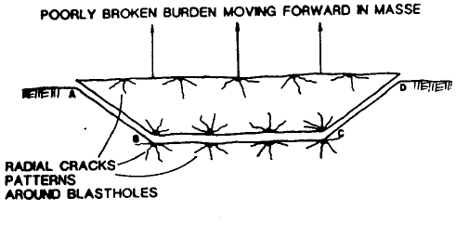
Single row delayed blast
Without delay:
A simultaneous pushing of the rock mass in front of the charges, horizontal shearing negatively affecting fragmentation because there is almost no in flight collisions of the projected rock and the breakage caused by shearing occurs only along pit floor level and in the lateral planes AB and CD

Slide 6
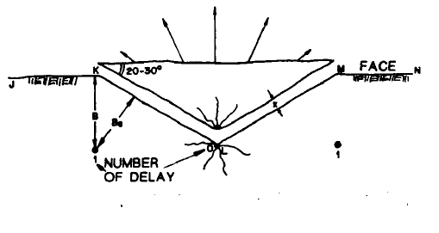
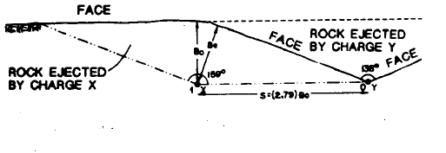
With delay:-
The radial cracks that develop around each explosive column are almost totally formed before the next charge is detonated.
The charges create additional free faces which means that each blast hole shoots to two faces, JK and KL

Slide 7
Fragmentation is better because the heave energy is used in vertically shearing the burden and extending the cracks and the strain wave has a larger field of action.
When the interval of delay between adjacent blast hole is long then optimum spacing So is equal to 2.79 B o.
The value of the spacing should be enough so that the cracks in the blast hole 0 and 1 develop totally without intersecting.
When S diminishes to under 2.79 Bo' the effective burden Be is somewhat less than optimum Bo and the fragmentation is poor, elevating the excavation costs

Slide 8
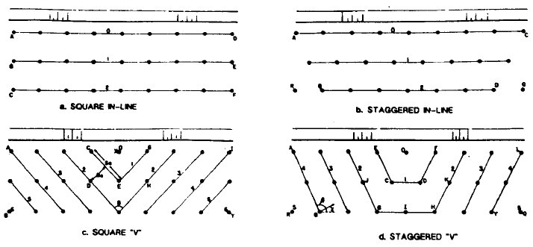
MULTI-ROW SEQUENCED BENCH BLASTINGS

Slide 9
criteria to be followed in multi row blasting
Each charge have a free face
Se/Be should be between 3 and 8
blast holes should be on a staggered pattern
rows with the same delay should form an angle of between 90 and 160°

Slide 10
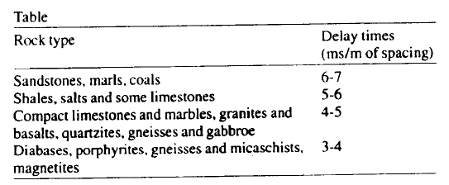
Table to calculate the delay times between blast holes, knowing the spacing between them and for different rock types

Slide 11
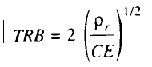
.
the following equation to calculate the delay time between blast holes
(ref. fadeev et al)
Where TRB = delay time between two blast hole(ms/m of burden)
ρ = rock density (t/m3)
CE = powder factor(kg/m3)

Slide 12
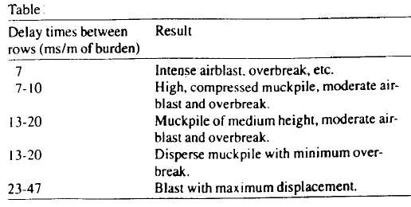
Table of delay time between row and it’s result

Slide 13
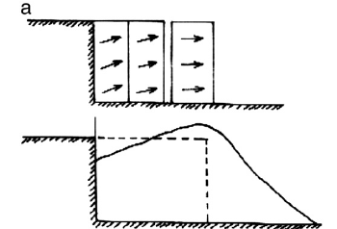
Effect of short delay and long delay on fragmentation
In the instances of short inter-row delay time, This causes vertical uplift that results in poor fragmentation (with little heave)and tight muck piles close to the face.

Slide 14
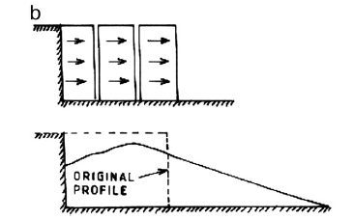
Effect of long delay on fragmentation
if the delay time between the rows is too large, the material of the first row fails to act as a screen and thus does not confine the remainder of the blasts, which results in unwarranted lateral scattering, poor fragmentation, fly rocks etc.

Slide 15
Field observation
Name of mine | Block 2
Seam | 5,6&7 combined seam
Type of rock | limestone
spacing | 5.5m
Burden | 5.5m
Dia. Of hole | 250mm
Bench floor | Inclined
Depth of hole | 20m
Firing pattern | diagonal
Type of explosive | Primary glycerin

Slide 16
Specification of NONEL
TYPE | STL | STL | DTH | DTH | DTH
Delay | 17ms | 25ms | 175ms | 200ms | 250ms
length | 6m | 6m | 20m | 12m | 8m
Batch no. | 209 | 198 | 85 | 43 | 89
Date of MFR. | 29.12.11 | 31.12.11 | 08.05.11 | 08.05.11 | 05.06.11
Row | First | Second | All | All | All
Position in the hole |  |  | Bottom | Middle | Top

Slide 17
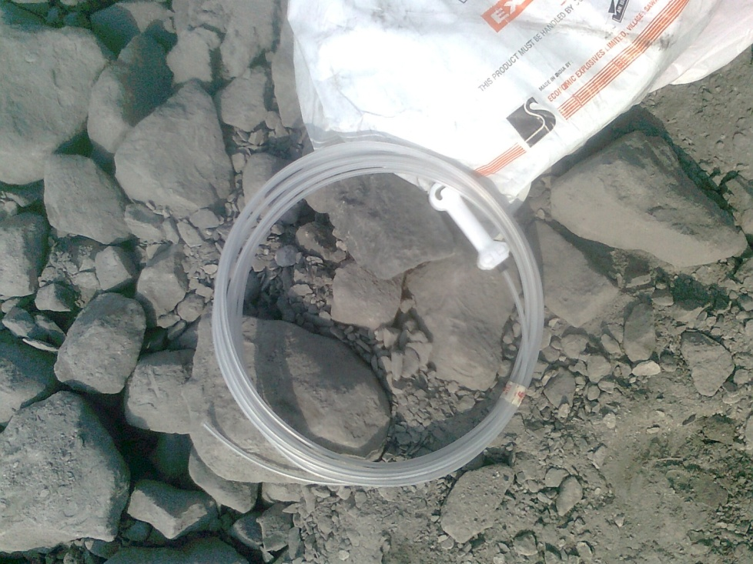
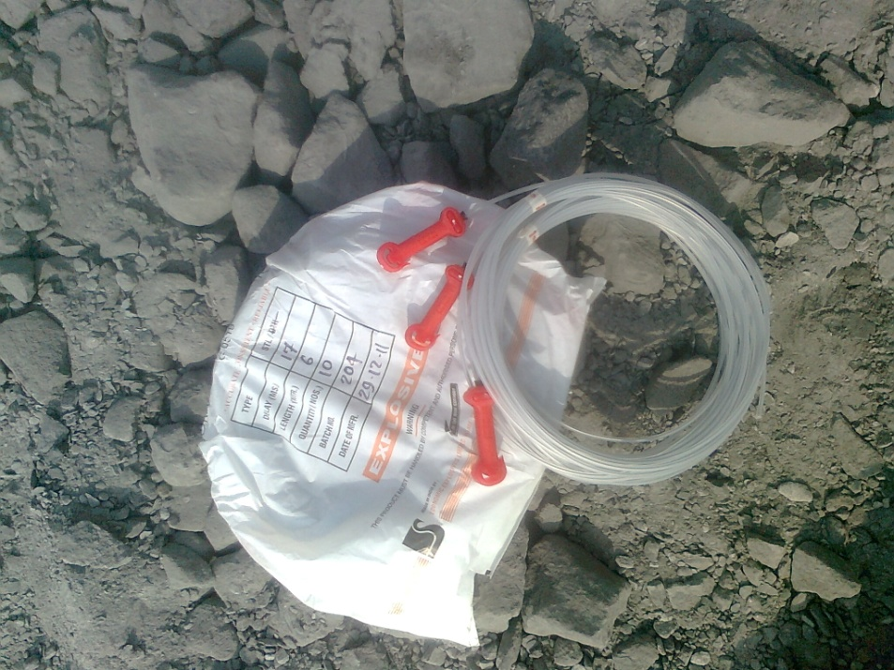
25ms&17ms NONAL

Slide 18
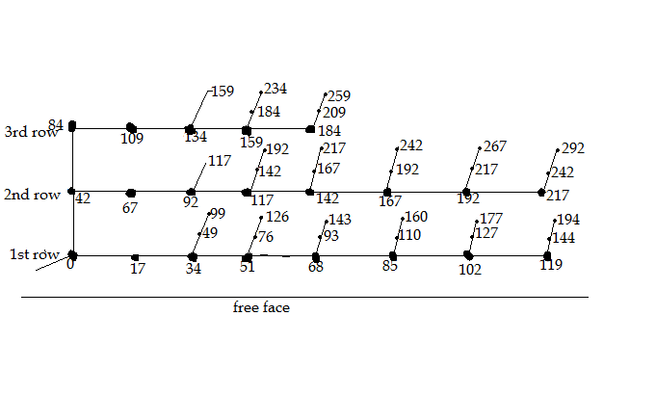
Firing pattern use in block 2 coal mine for removal of overburden
Fig :-diagonal firing pattern with inter hole delay by use of NONAL

Slide 19
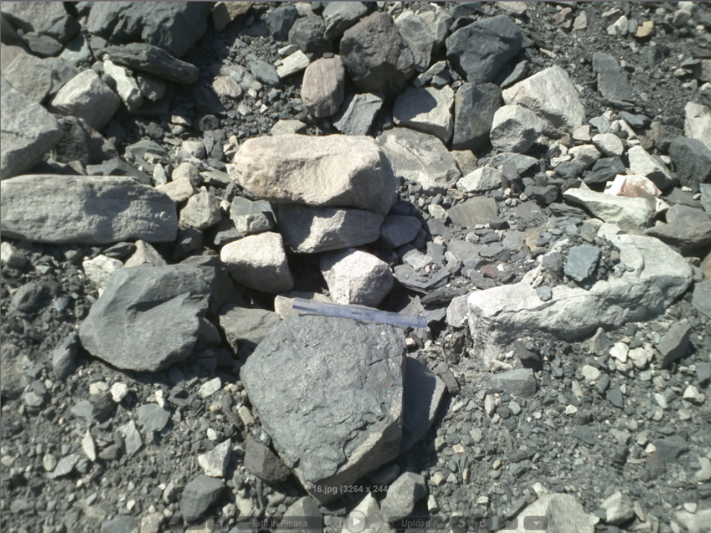
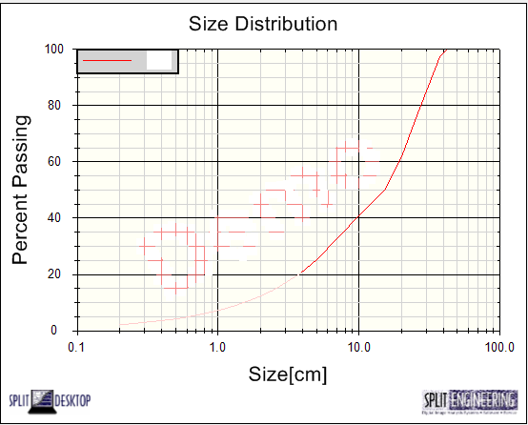
Result from fragmentation without inter hole delay by split-desktop software of picture 1 d50=16cm

Slide 20
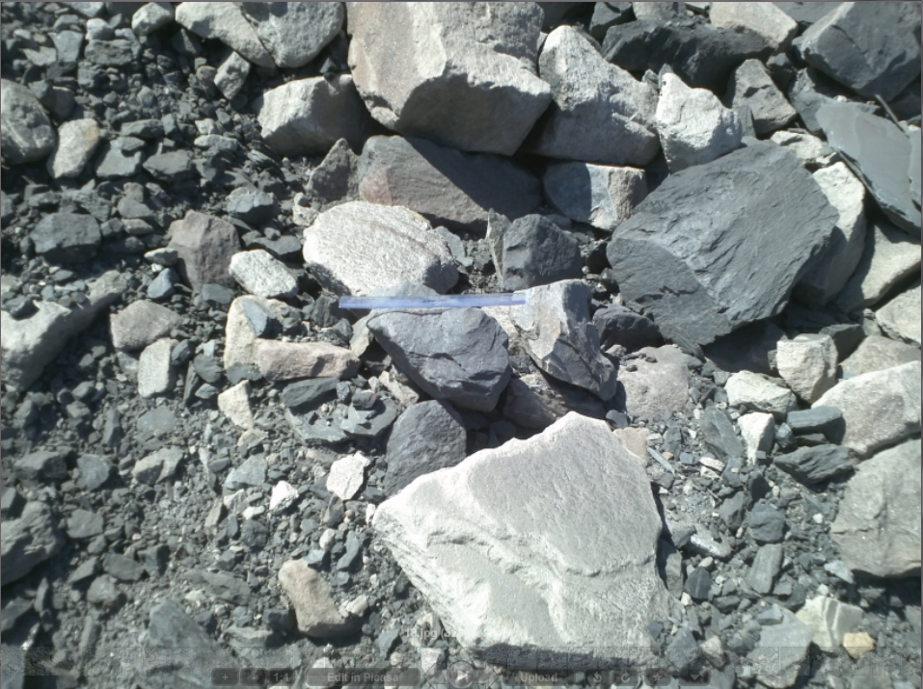
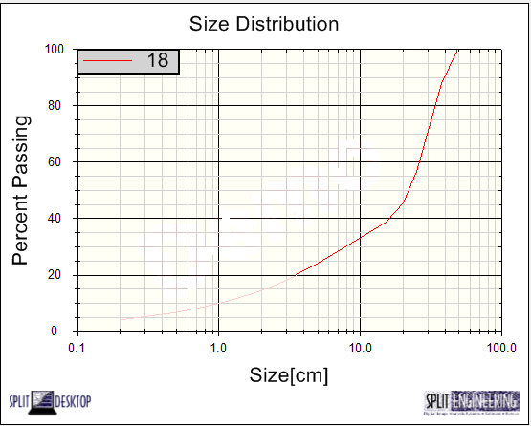
Picture 2 d50=23cm

Slide 21
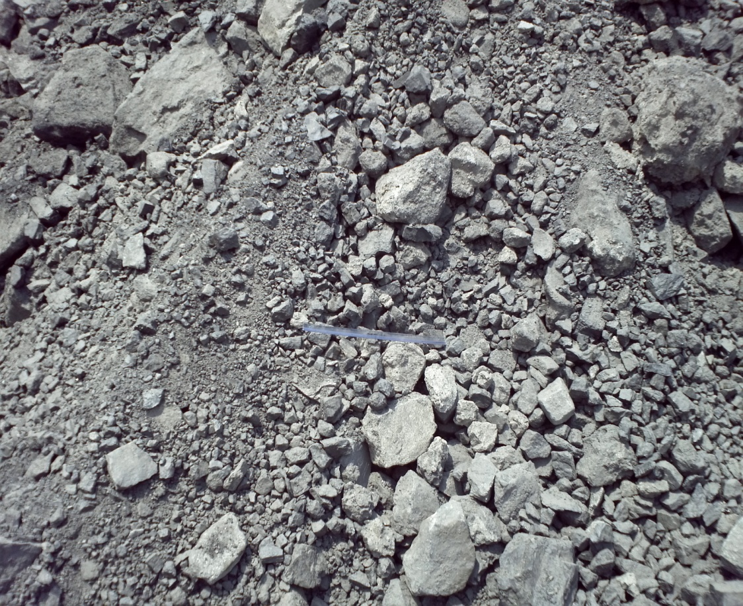
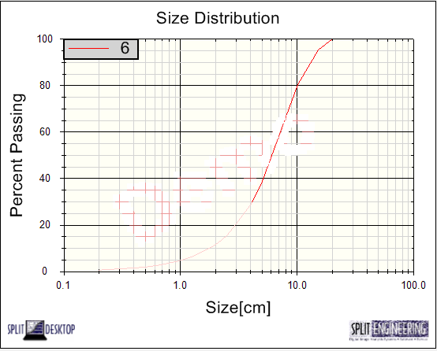
Result from fragmentation with inter hole delay by split-desktop software of picture 1 d50=6cm

Slide 22
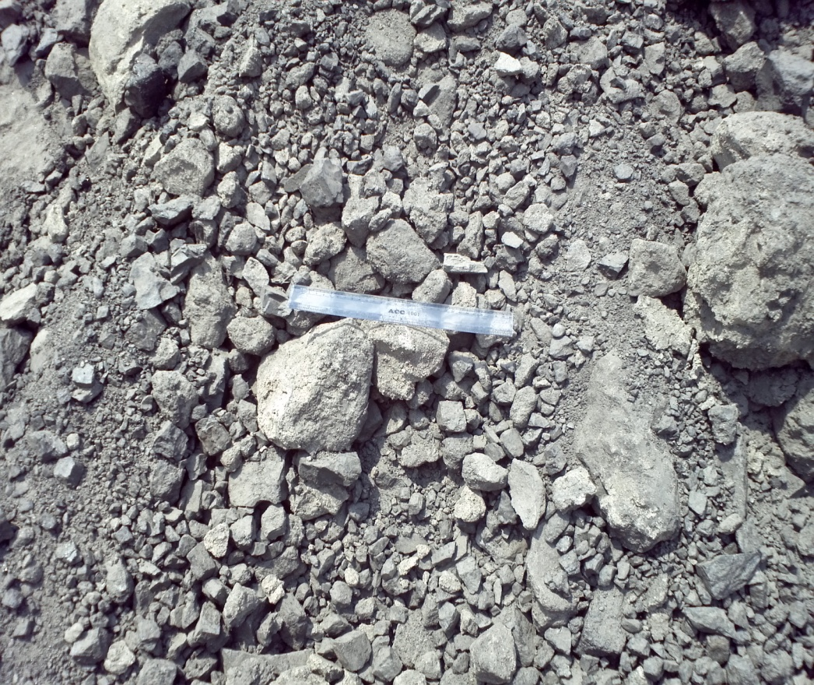
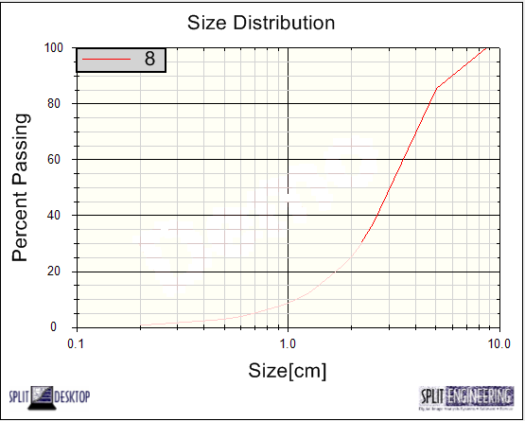
Picture 2 d50 =3cm

Slide 23
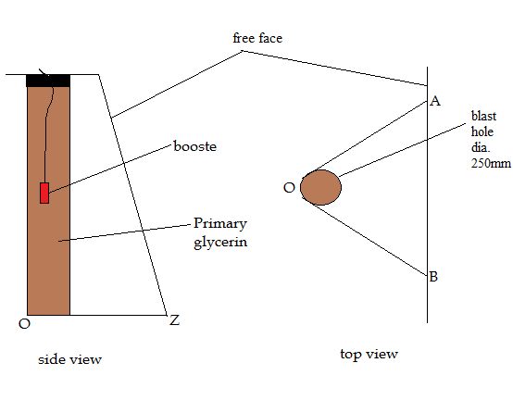
without inter-hole delay

Slide 24
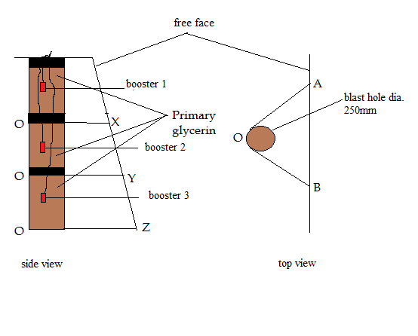
With inter-hole delay

Slide 25
When inter hole delay is not provided then shearing occur along plan OA,OB & OZ.
When inter hole delay is provided then shearing occur along AO,OB & OX,OY,OZ.
In the case of inter-hole delay there is extra free face is provided then upper part of hole has been blast.
And cracks fully developed without intersecting the other crack before reach to the free face.

Slide 26
Result
Average of mean fragmentation is 19.5cm without inter-hole delay. And more no. of large size boulder in the blasted rock mass
Average of mean fragmentation is 4.5cm with inter hole delay. And less no. of large size boulder in the blasted rock mass

Slide 27
References
Hyung-Sik Yang, Piyush Rai, Characterization of fragment size vis-à-vis delay timing in quarry blasts(2010)
CARLOS LOPEZ Jimeno book ‘Drilling and blasting of rock’ chapter no. 27(1995) page no. 281-288
R. Banda* and N. Rhodes , Electronic delay detonators—a unique solution to pertinent mining problems, VOLUME 105(October 2005)
Kathryn Podoliak, dyno nobel, The Evolution of the Detonator(2004) page no. 9-23
DMVP slovenda, rock fragmentation page no. 14-17
P.D. Katsabanis, A. Tawadrous, C. Braun and C. Kennedy,Time effect of fragmentation, International Society of Explosives Engineers (2006)
Dr P Rai, Fellow, Modifications in the Firing Pattern, Stemming Column and Bench Stiffness for Improved Blast Performance in Limestone Quarry of the Philippines, IE(I) Journal–MN(2007)

Slide 28
Thank you

